Slide 1

CAP444 OBJECT ORIENTED PROGRAMMING USING C++
Created By:
Amandeep Kaur
SCA (LPU)

Slide 2
Topics Covered
Principles of OOP :
classes and objects,
access specifiers,
constructors: types of constructors,
multiple constructor in a class,
destructors,
friend function,

Slide 3

Class
Class is a collection of similar types of objects.
For example: Fruits is class of mango, apple , orange etc.
Fruits

Slide 4
Class is a template to create objects.
It is a user-defined data type, which holds its own data members and member functions, which can be accessed and used by creating an instance of that class.
For Example: Consider the Class of Cars. There may be many cars with different names and brand but all of them will share some common properties like all of them will have 4 wheels, Speed Limit, Mileage range etc.
When a class is defined, no memory is allocated but when it is instantiated (i.e. an object is created) memory is allocated.

Slide 5
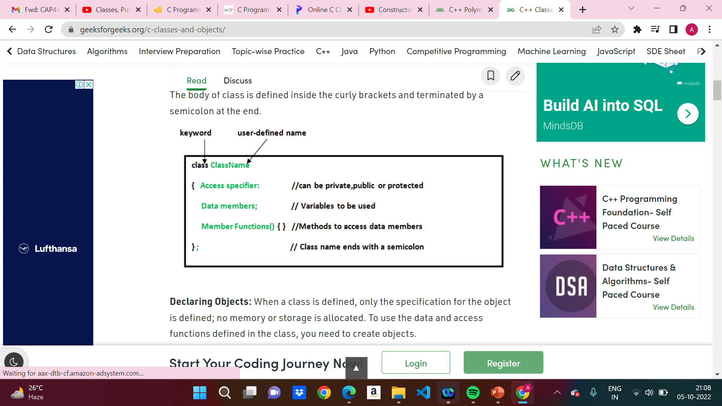
Syntax of Class
Declaring Object
ClassName ObjectName;

Slide 6
Class
Class is a collection of data members and member functions.
Example:
class Employee{
//data members
// member functions
}
Employee
employeeId employeeName
getDetails() setDetails()

Slide 7
Object
Object is an instance of a Class.
class Employee
{
int employeeId;
char employeeName[20];
public:
void getDetails(){}
void setDetails(){}
};
int main()
{
Employee e1; // e1 is a object
return 0;
}

Slide 8
In this code which option is correct?
class student
{
public:
int regno;
void getStudentDetails();
}
A: regno is data member
B. getStudentDetails() is member function
C. above both options are correct

Slide 9
access specifier
private
public
protected
By default, all members of a class are private if you don't specify an access specifier.

Slide 10
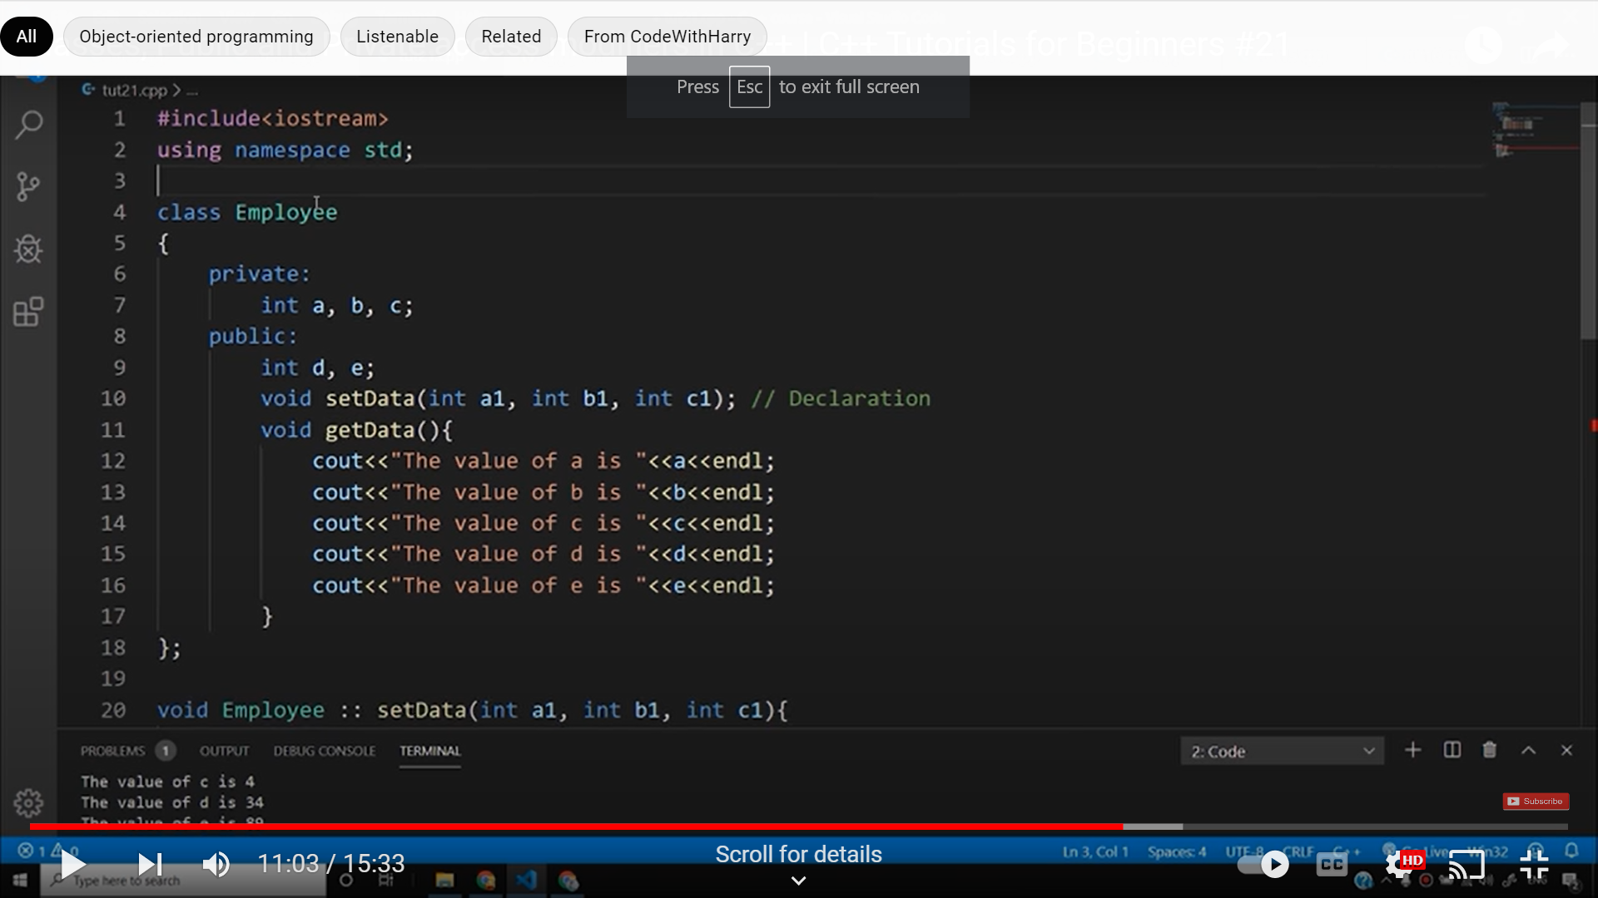
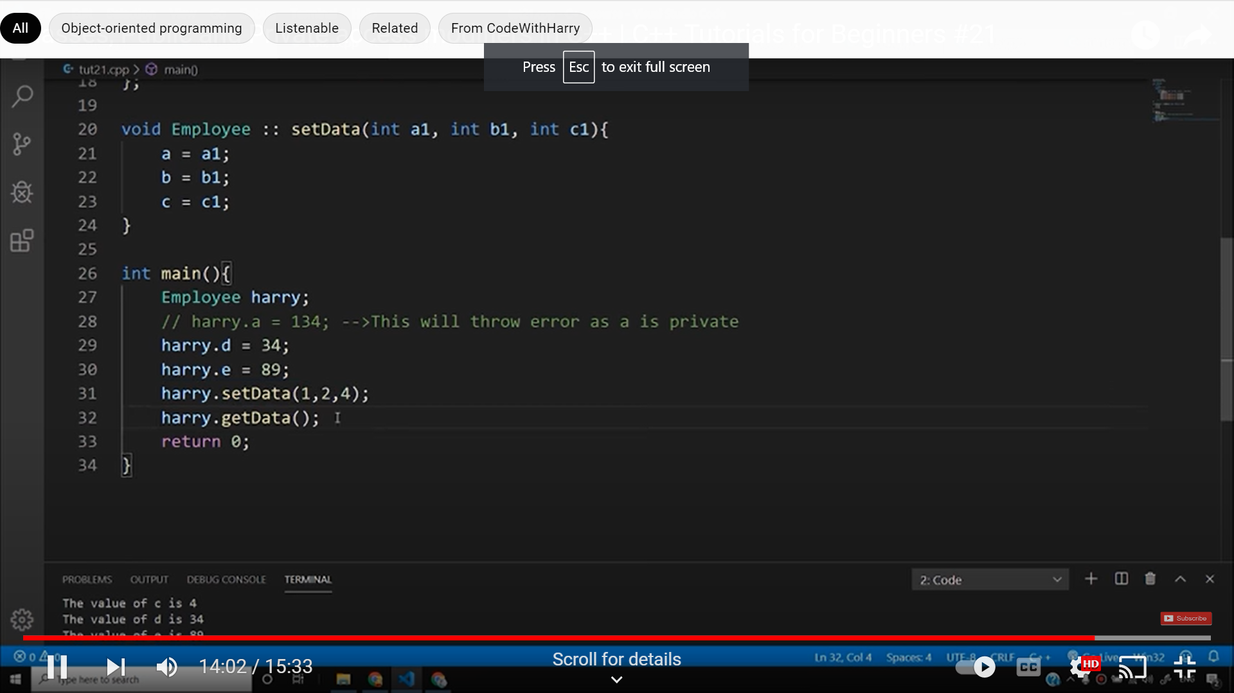
Function define outside the class

Slide 11
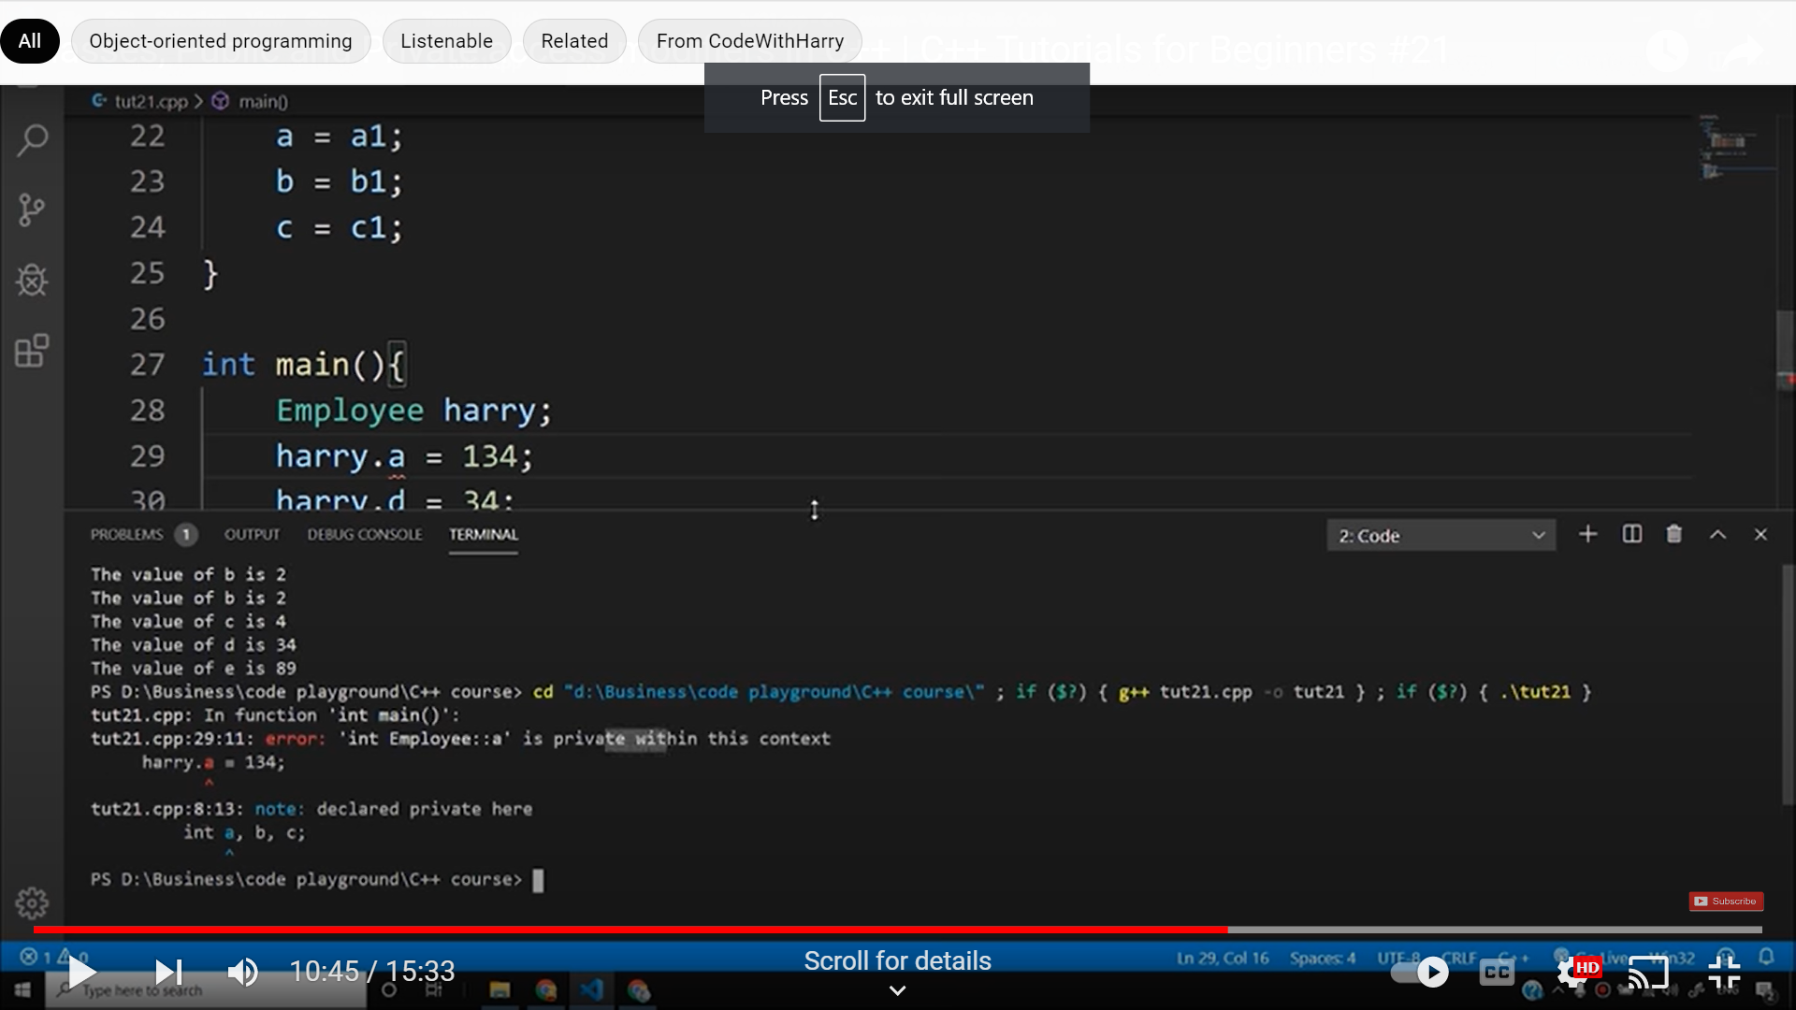
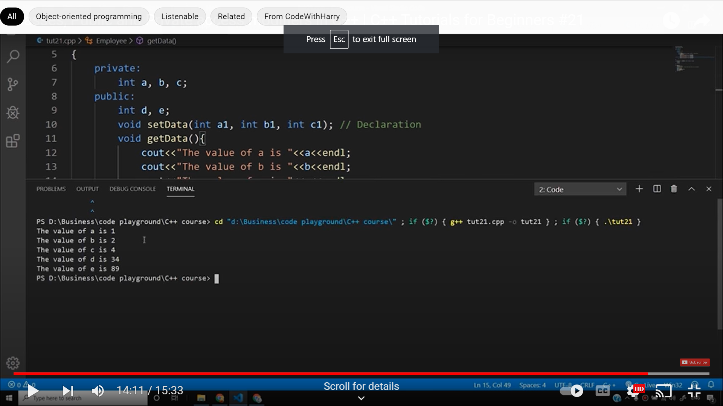

Slide 12
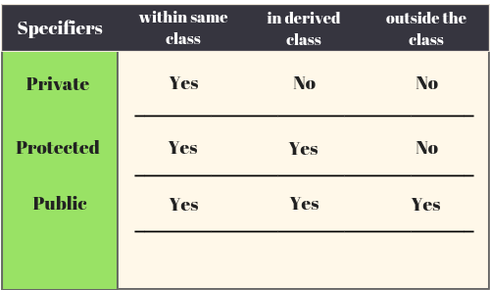

Slide 13
Select correct option
class Employee
{
int employeeId;
char employeeName[20];
public:
void getDetails(){}
void setDetails(){}
};
int main()
{
Employee e1;
e1. employeeId=1234;
cout<< e1. employeeId;
return 0;
}
1234
0
Compilation error
Run time error

Slide 14
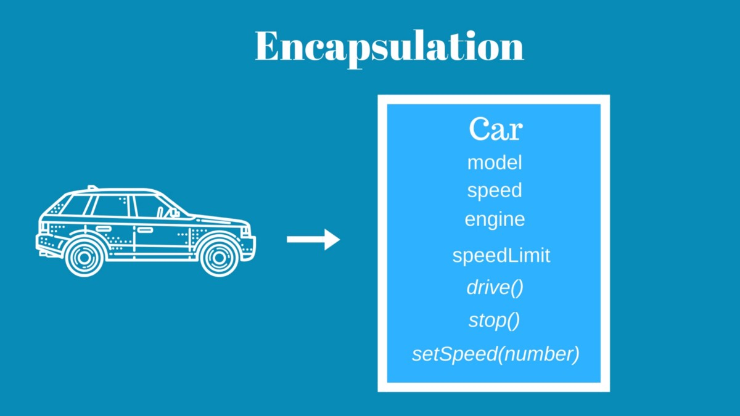
How to achieve encapsulation features in C++? Encapsulation is defined as wrapping up of data and information under a single unit. In Object Oriented Programming, Encapsulation is defined as binding together the data and the functions that manipulates them.

Slide 15
How to achieve encapsulation features in C++?
Define private data members in a class and
Define public set and get accessors functions which can be used to access these private data members.
Why Encapsulation?
Increased security of data

Slide 16
Any Query?

Slide 17
